Slide 1
The Request/Response Cycle
Or, what happens when you type something into the address bar

Slide 2
How Does This All Work?
When you type an address into the URL bar, what happens?

Slide 3
Client/Server Relationship
Servers
Machines that hold shared resources
Always connected to the network
Clients
Machines for personal use (laptops, phones, etc.)

Slide 4
Request/Response Cycle
This is what happens when your computer (the client) requests a page and a server responds with the appropriate files.

Slide 5
Uniform Resource Locator
URL – three parts:
protocol – how to connect
http, https, file, ftp, etc..
domain – where to find the document you want
umich.edu, google.com, wikipedia.org
document – what specific file is needed*
Most pages are made up of multiple files

Slide 6
Document
URLs can specify a specific document
http://www.intro-webdesign/contact.html
http://www.intro-webdesign/Ashtabula/harbor.html
https://www.wikipedia.org/
https://pbs.twimg.com/profile_images/94.jpg
If no document is specified, the default document is returned.
Convention is index.html

Slide 7
The Request
Once the IP address is determined, the browser creates an HTTP request.
Lots of hidden information in this request
header, cookies, form data, etc

Slide 8
The Response
The server returns files/output, not “web pages”
It is up to the browser to decide what to do with that info
If the server can’t fulfill the request it will send back error codes: 404, 500, etc.

Slide 9
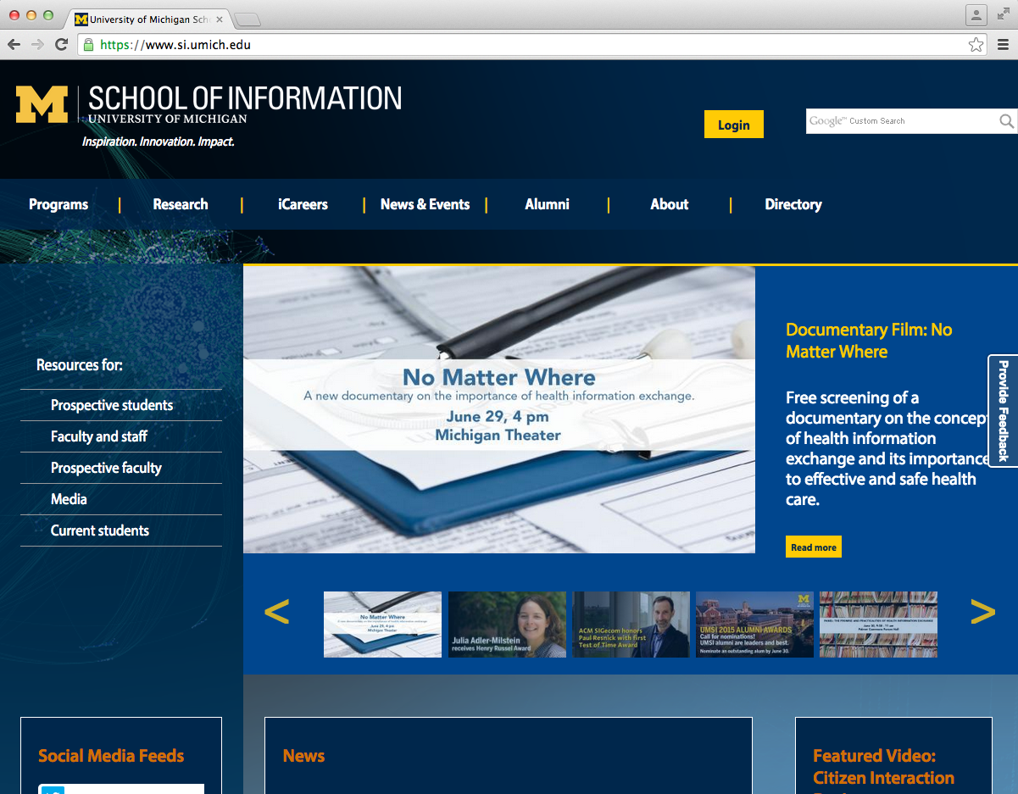
What happens when you type “http://si.umich.edu/” into the address bar.
1. The browser look up the domain in the DNS
The Request/Response Cycle is initiated
2. The DNS returns the IP address:54.88.175.189
3. The browser sends an HTTP request to the server located at that address.
4. The server finds the requested and sends it back as a response.
5. The browser takes the response and renders the HTML code as a nice graphical presentation, often repeating steps 3 – 5 as needed to request images and other supporting files.

Slide 10
Review
A URL typically requires multiple rounds of the Request/Response cycle.
The browser must request the main file but any supporting files and images are also returned

Slide 11
HTML5
What it is…and why we aren’t
starting at HTML 1.0

Slide 12
What is HTML?
HTML stands for Hypertext Markup Language
Markup languages are not the same as programming languages, they use tags to annotate documents.
In HTML the tags indicate where headings, images, lists, links, line breaks, and other components should go.

Slide 13
.html files
When your computer opens a .html file, it knows to open it in an Internet browser (Chrome, Firefox, Safari, etc.)
The browser can read this file and know how to display it on the screen.
Screen readers and other assistive devices can also utilize the HTML tags to present the information is special ways.

Slide 14
“Learning” HTML
In the beginning you worry about syntax
What tags are there?
Did I remember to “end” my tag?
Later, you will worry about semantics
Is there a tag that better conveys the meaning I am trying to get across?
If someone is searching my page can they find what they need and access it easily?

Slide 15
Web Standards
No one “runs” the Internet or the Web, some groups do take proactive roles:
Internet Engineering Task Force (IETF)
World Wide Web Consortium (W3C)
The Web Accessibility Initiative (WAI)

Slide 16
Evolution of HTML
1993 | HTML 1.0 - Developed by Tim Berners-Lee to link document
1995 | HTML 2.0 - Developed by Internet Engineering Task Force RFC to include stylized text and tables
1996 | CSS 1
1997 | HTML 3.2 – Developed by W3C and included browser specific features
1997 | HTML 4.0 – A move back to normalizing the pages across platforms.
1998 | CSS 2
1999 | HTML 4.01 – Introduced different document types
2012 | HTML 5 - Back to HTML plus multimedia and semantic tags

Slide 17
Where we are now
HTML5 is a cooperation between W3C and the Web Hypertext Application Technology Working Group(WHATWG)
Established Guidelines
New features should be based on HTML, CSS, the DOM, and JavaScript
Reduce the need for external plugins (e.g. Flash)
More markup to replace scripting
HTML5 should be device independent

Slide 18
Review
Browsers translate HTML documents into viewable webpages
HTML was intended to facilitate content types
When designers want to do something new they write non-standard code to force browsers to do it
New standards are written to handle new requirements and browsers adopt the new standards

Slide 19
Document Object Model
Writing clean code

Slide 20
The Document Object Model (DOM)
Basis of HTML5 is “New features should be based on HTML, CSS, the DOM, and JavaScript…”
DOM provides common tree-like structure that all pages should follow
Computer Scientists love trees (the mathematical kind) because you can test them.

Slide 21
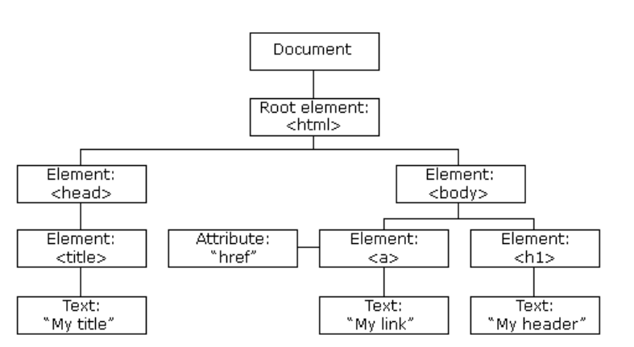
HTML is built on the DOM
http://www.w3schools.com/js/js_htmldom.asp

Slide 22
Three parts of a well-formed document
Doctype
Version of HTML that you will be using
Head
Metadata
Body
Displayable content

Slide 23
Doctype
HTML5
<!DOCTYPE html>
Previous versions dictated backwards compatibility
<!DOCTYPE HTML PUBLIC "-//W3C//DTD HTML 4.01//EN" "http://www.w3.org/TR/html4/strict.dtd">
<!DOCTYPE HTML PUBLIC "-//W3C//DTD HTML 4.01 Transitional//EN" "http://www.w3.org/TR/html4/loose.dtd">

Slide 24
Head
Additional information used by the browser
Meta data – language, title
Supporting files – JavaScript, Styling, Add-ons
Other than title, meta-data is not displayed

Slide 25
Body
Bulk of your page
Important to write well-formatted (tree-like) code.
Most of the content is displayed by the browser, but there may be some meta-data too

Slide 26
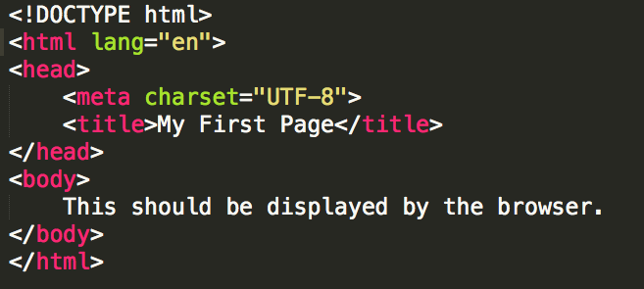
Example
Example: template.html

Slide 27
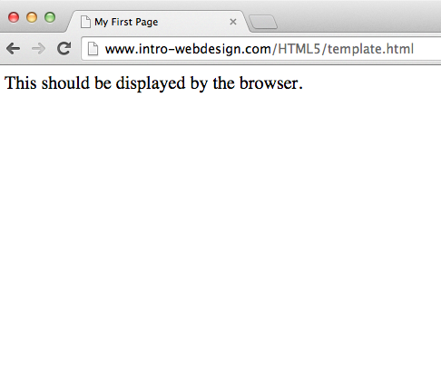

Slide 28
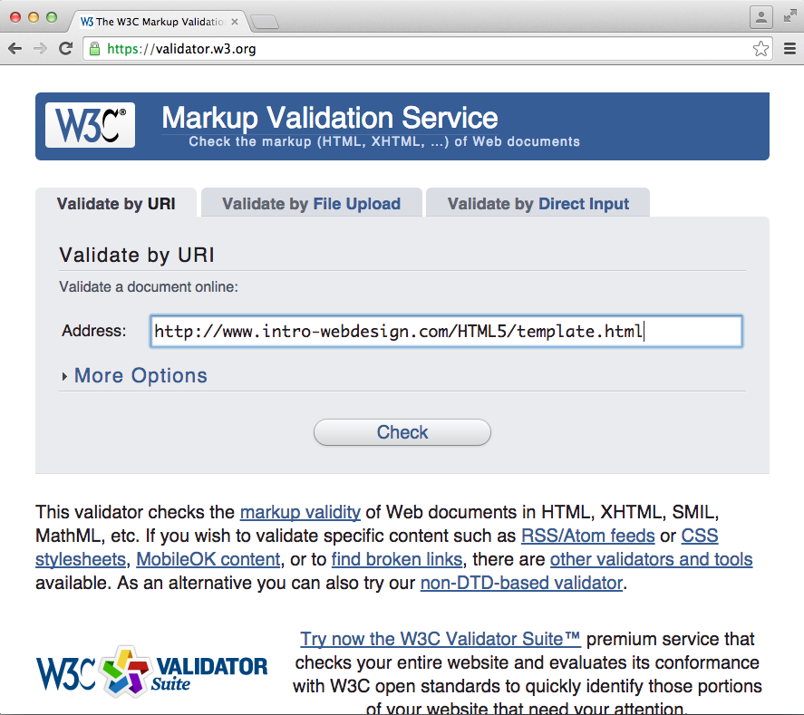
Validate the Code

Slide 29
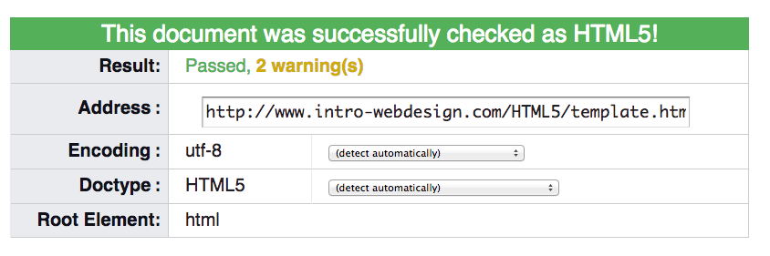
Success!!

Slide 30
HTML5 Tags and Syntax
My first big disappointment to you.

Slide 31
HTML tags
I can’t teach you all of the tags
I can’t teach you all of the tags
You don’t want me to teach you all of the tags

Slide 32
Finally, some tags…
Tags have a beginning and an end
Some tags have attributes (src, href, etc..)
<h1>Hello World</h1>
Start tag
Closing tag
<img src=‘’x.gif” />
Self-closing tag

Slide 33
Display
One of the most important attributes of an element is its display. The two most common are block and inline
block (can take width and height)
Newline is inserted before and after, e.g. it “Takes up” whole width
inline (can not take width and height)
Only uses as much space as needed to contain the element.

Slide 34
Common Tags
Headings (block)
<h1>, <h2>, <h3>, <h4>, <h5>, <h6>
These tags have syntax and semantics
Paragraphs (block)
<p> …. </p>
Should only contain inline elements
Divs (block)
<div>...</div>
Generic section that is larger than a paragraph

Slide 35
More tags
Ordered lists
<ol>
<li> Item One </li>
<li> Item Two </li>
</ol>
Unordered lists
<ul>
<li> Item One </li>
<li> Item Two </li>
</ul>
Line breaks
<br/>

Slide 36
Attributes
Attributes provide additional information about an element
Always specified in the start tag
Attributes come in name/value pairs

Slide 37
Images
Images (inline)
<img src = “myPicture.jpg” alt = “Image of Colleen”/>
Images rarely work the first time
Show a broken link, too big, too small, etc.
Save yourself heartache and size/carefully name your picture before you use it.

Slide 38
Images
<img src=”logo.jpg”
alt="company logo"
title = "AAA1 LLC"
class = "thumbnail"/>
Image filename
Info for screen readers, broken links
Displays on hover
Extra formatting (height, width, position, etc.)

Slide 39
More Attributes
As you learn the tags, you learn their specific attributes. Some apply to any tag
class – applies special properties to groups of elements
id – specifies a unique id to one element on the page
style – specifies a certain visual style (avoid this one!!!)
accesskey – a shortcut key to activate an element
tabindex – the order that the tab butotn brings elements into focus

Slide 40
Hyperlinks
Creating a linked document

Slide 41
Links
Links are what make the Web a web.
The interlinked nature of the web leads to the “knowledge” that search engines appear to have.

Slide 42
Types of links
External
Absolute
Relative
Internal
Graphical

Slide 43
Anchor links
The <a> tag stands for anchor link
Links have one attribute within the tag AND need additional content
Attribute: reference to location of new content
Content is the “clickable” part, may be text or image.

Slide 44
Absolute reference
<a href="http://www.intro-webdesign.com/">Web Design</a>
Closing
tag
Where to go on click
Opening tag
Clickable text

Slide 45
Relative References
<a href=“page2.html">Second Page</a>
Local file in the same folder
<a href=“docs/page2.html">Second Page</a>
Local file in a different folder
<a href=“#history">History section</a>
Segment in this same file that has been identified as history section

Slide 46
Absolute vs Relative
When would you use absolute links?
Are there any benefits to using local links?
Your links should NEVER have folders that are specific to your computer
C:\page2.html

Slide 47
Using Images as the Link
The “clickable” component doesn’t have to be text.
<a href="http://www.redcross.org">
<img src = "http://www.redcross.org/images/redcross-logo.png"
alt = "Red Cross logo"/>
</a>
<a href="http://www.redcross.org">
<img src = ”imgs/redcross-logo.png” alt = "Red Cross logo"/>
</a>

Slide 48
Usability Issues
Make sure the clickable component has an informative name
Information in the images should be available to those who can’t see the image using an aria-label attribute

Slide 49
Special Entities
Tags always start with a bracket (<)
What if you want the browser to display a bracket, not start a tag?

Slide 50
Special Entities
If you want…. | Then use…
< | &lt;
> | &gt;
© | &copy;
blank space | &nbsp
¢ | &cent;
& | &amp;

Slide 51
Review
How do you know the difference between a tag and an attribute?
What two symbols end a self-closing tag?

Slide 52
Semantic HTML5 Tags

Slide 53
How to Design
<header>
The most important step in web design is the design.
You need a clear picture of what you want to create, before you can begin coding.
<section>
<aside>
<article>
<footer>

Slide 54
Using Semantic Tags
In the beginning (insert dramatic music of your choice…) there was div
<div> was a way to group related content together
Divs almost always had special classes/ids associated with them
<div class = “header”>…</div>
<div class = “navigation”>…</div>
<div class = “footer”>…</div>

Slide 55
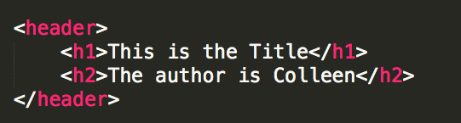
<header>
A group of introductory or navigational aids: title, navigation links,
Not to be confused with <head> or the different headings.

Slide 56
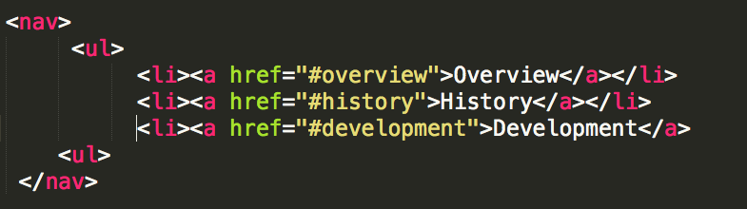
<nav>
A section of the page that links to other pages or to parts within the page.
Often found in the <header> tag

Slide 57
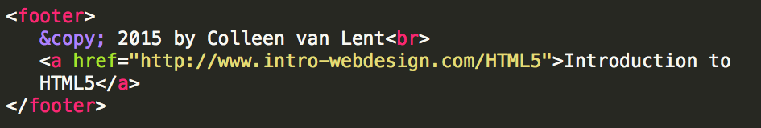
<footer>
A section that contains info such as copyright data, related documents, and links to social media
Typically at the bottom of the page, but not required.

Slide 58
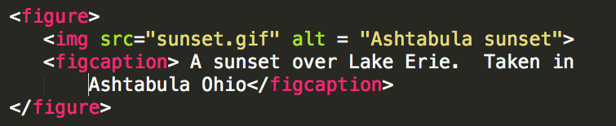
<figure>
More semantics than image. Can include:
caption
multiple multi-media resources

Slide 59
Other New Tags
Structural Elements
article, aside, main, menuitem, summary, section
Form Elements
datalist, keygen, output
Input Types
color, date, email, list
Graphics Elements
canvas, svg
Media Elements
audio, embed, source, track, video

Slide 60
“Notes”
Learn to Use Inspect Element – You will use it OFTEN
Get in the habit of using the w3 validator
Don’t put your class files in a ”deep” folder structure. You will be accessing the files frequently.

Slide 61
Discussion and To Do
Discussion
Create a Github account and your first GitHub pages repository
Decide on your editor and add any plugins
Install Axe
To Do
Begin your 4 page “portfolio”

Slide 62

Acknowledgements/Contributions
These slides are Copyright 2015- Colleen van Lent as part of http://www.intro-webdesign.com/ and made available under a Creative Commons Attribution 4.0 License. Please maintain this last slide in all copies of the document to comply with the attribution requirements of the license. If you make a change, feel free to add your name and organization to the list of contributors on this page as you republish the materials.
Initial Development: Colleen van Lent , University of Michigan School of Information

